Slide 1
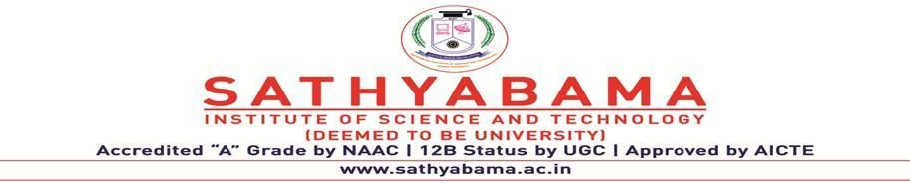

PREDICTING THE GOLD PRICES USING LINEAR REGRESSION
PROJECT SUPERVISOR : DR.M.D.ANTO PRAVEENA
NAME OF STUDENT : A. TEJASWI
REGISTER NUMBER. : 39110040

Slide 2
PRESENTATION OUTLINE
Introduction
Objectives
Ideation Map
Hardware and Software requirements
Module Implementation
Algorithms and Methods
Results
Conclusion
References

Slide 3
INTRODUCTION
Historically, gold had been used as a form of currency in various parts of the world including USA.
Gold has been the original store of value and medium of exchange to mankind for centuries till paper currency took over a couple of centuries ago.
In present times, precious metals like gold are held with central banks of all countries to guarantee re-payment of foreign debts, and also to control inflation which results in reflecting the financial strength of the country.
India has wide range of population who buy and sell gold and silver a lot and usage of gold is preferably more than any other metal.

Slide 4
OBJECTIVES
We will create a machine learning linear regression model that takes information from the past Gold ETF (GLD) prices and returns a Gold price prediction the next day.
GLD is the largest ETF to invest directly in gold.
Forecasting rise and fall in the daily gold rates, can help investors to decide when to buy (or sell) the commodity.
For the purposes of profitability, it is more important to predict the relative change in price tomorrow (i.e. whether the price will go up or down) than to predict the absolute price tomorrow.
In my project, I chose to apply supervised learning to the prediction of gold prices in order to see what kind of success I could achieve.

Slide 5
IDEATION MAP
START
EXTRACT THE DATASET
ANALYZE THE DATA
SPLIT THE DATASET
MODEL EVALUATION
MODEL LEARNING
TRAINING SET
TESTING SET
We use the above steps to make predictions with our regression model

Slide 6



HARDWARE AND SOFTWARE REQUIREMENTS
HARDWARE REQUIREMENTS : A laptop with good internet connection.
SOFTWARE REQUIREMENTS : Anaconda software and Jupyter notebook

Slide 7
MODULE IMPLEMENTATION
SKLEARN
*Free software machine learning library for python programming
NUMPY
(NUMERICAL PYTHON)
*General-purpose array-processing package.
*High performance
PANDAS
*Software library for python programming
*Data manipulation
*Data analysis
SEABORN
*Python data visualization library
*High level interface for drawing statistical graphs
MATH
*Built in module for mathematical tasks
MATPLOTLIB
*Plotting library for the python programming language and its numerical maths extensions NumPy

Slide 8
ALGORITHMS
LINEAR REGRESSION :
It is a machine learning algorithm based on supervised learning. It performs a regression task.
•Regression models a target prediction value based on independent variables.
•It is mostly used for finding out the relationship between variables and forecasting.
•Different regression models differ based on – the kind of relationship between dependent and independent variables they are considering, and the number of independent variables getting used.

Slide 9
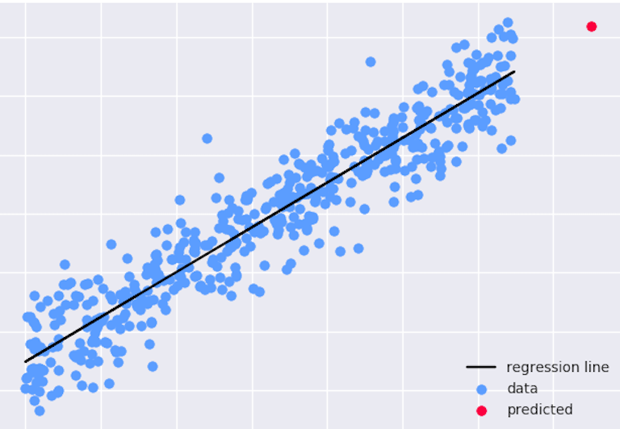
METHODOLOGY
Linear regression uses the least square method.
The concept is to draw a line through all the plotted data points. The line is positioned in a way that it minimizes the distance to all of the data points.
The distance is called "residuals" or "errors". It makes the problem easy and understandable.

Slide 10
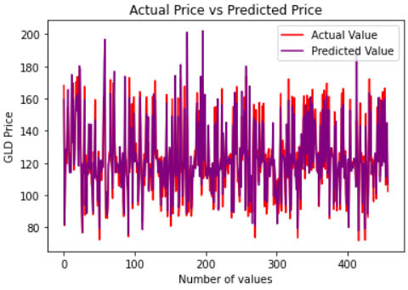
SNAPSHOTS OF THE MODEL

Slide 11
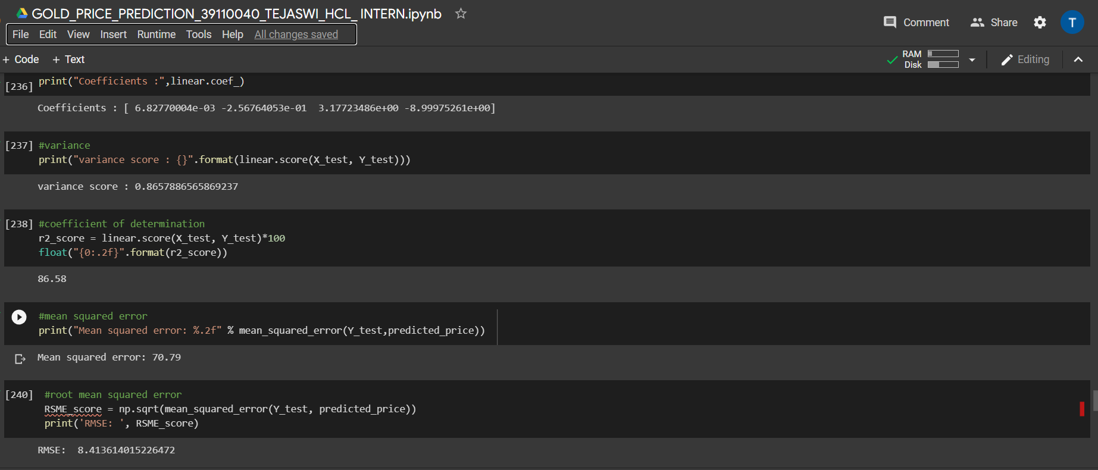
SNAPSHOTS OF THE MODEL

Slide 12
RESULTS
The variance , mean squared error, root mean squared error, testing accuracy and training accuracy (i.e,R2 score) values for predicting the gold prices using linear regression are:
 | TEST DATA | TRAIN DATA
MEAN SQUARED ERROR(MSE) | 70.79 | 62.69
ROOT MEAN SQUARED ERROR(RMSE) | 8.413614015226472 | 7.917673127163984
VARIANCE | 0.8657886565869237 | 0.8850695972446934
ACCURACY (R2 SCORE) | 86.58 | 88.51

Slide 13
CONCLUSION
As you saw in this project, we first train a machine learning model, then use the trained model for prediction.
Similarly, any model can be made much more precise, by feeding a very large dataset, to get a very accurate score (but it will be pretty time-consuming).
Here we used linear regression to predict the gold prices and compared the actual and predicted prices.
This is very informative for investors and people who tends to buy or sell gold and can predict the values beforehand.

Slide 14
REFERENCES
GLD ETF Report: Ratings, Analysis, Quotes, Holdings | ETF.com
Gold Price Prediction: Step By Step Guide Using Python Machine Learning (quantinsti.com)
Building A Gold Price Prediction Model Using Machine Learning - (analyticsvidhya.com)
gold price dataset | Kaggle
Potoski-PredictingGoldPrices.pdf (stanford.edu)

